Slide 1
Esoft ChatBot
Assignment - 02
Group Members:
BEng(Hons) in SE - London Met UK

Slide 2
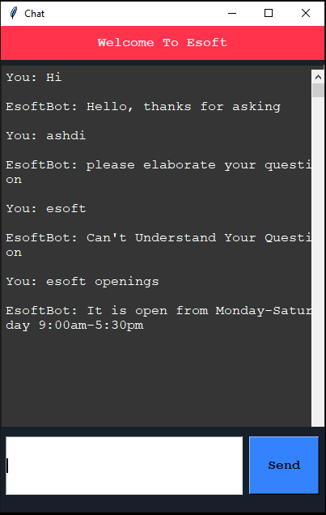
Introduction
The Esoft chatbot is developed using python, pytorch and tkinter in order to achieve the functionality of NLP and AI chat replying for basic esoft queries.
Using predefined Intents the chat bot will interact with the user queries.

Slide 3
How Chatbot Trains?
Training Data to Chatbot
We will use an instant.json different intantas in an array of tags as questions and multiple responses. Through tcontaininghe code logic these words get processed in 3 stages
Tokenizing
Where the user input get split into meaningful units . Ex : [“How”,”are”,”you”]
Steemimg
Generate multiple words from a word. Ex: Computer in to [Compute, Comp]
Bag of words
Then this bag of word algorithm matches the user input words from intents json file and response

Slide 4
After Training?
After Bot got trained, the data will be stored in a different file where it gets converted and stored as binary values
By using our GUI interface users can now provide their queries as an input, and right after that they can press enter. After this the user input will also go into same tokenize, stemming and bag of word process, then the bag of words will store binaries of each words and try to match with the intents data where we already have compiled and stored as binary.
The the bot will process both the matching data and response with proper text words according to what user asked for.

Slide 5

Let’s Try Our Esoft Bot!!!

Slide 6
Thank You!!!!!!

